Slide 1


Multi-Tenant SaaS-Based Student Learning Management System
CSA1522-CLOUD COMPUTING & BIG DATA ANALYTICS
Guided by :
Dr. Rajaram P
Name of the student :
K.Dhilip(192365013)
Sanjay kumar soy(192311151)
T.Subahan(192511121)

Slide 2
Introduction
A Learning Management System (LMS) is a software application used to manage online learning activities.
Traditional LMS platforms often require separate installations for each institution, leading to higher costs and maintenance.
A Multi-Tenant SaaS LMS enables multiple educational institutions to use a single cloud-based application while keeping each institution's data isolated and secure.
Cloud technologies provide scalability, reliability, and easy access from anywhere using the internet.
Notes:
Image source: https://pub.mdpi-res.com

Slide 3
Abstract
This project presents a Multi-Tenant SaaS-Based Student Learning Management System that allows multiple educational institutions to share a single cloud-hosted application while maintaining complete data isolation for each tenant.
The system provides secure user authentication, role-based access control, course management, online assessments, and subscription billing. By adopting cloud computing techniques such as multi-tenancy, load balancing, and auto-scaling, the platform delivers high availability, reduced infrastructure costs, and simplified maintenance.
The proposed solution improves learning accessibility, supports institutional growth, and offers an efficient Software-as-a-Service (SaaS) model for modern education.
Notes:
Image source: https://www.mdpi.com

Slide 4
Problem statements
Traditional Learning Management Systems require separate installations and servers for each institution, resulting in high deployment and maintenance costs.
Managing users, courses, and assessments across multiple institutions becomes difficult without secure data isolation and centralized administration.
Existing systems often struggle to handle increasing numbers of users during peak academic periods due to limited scalability and inefficient resource utilization.
Existing LMS platforms often lack flexible subscription and billing management, making it difficult for institutions to choose plans based on their size, users, and resource requirements.
Notes:
Image source: https://www.mdpi.com

Slide 5
Objectives
To design a cloud-based multi-tenant learning management system that securely serves multiple educational institutions using a single shared application.
To provide efficient course management, online assessments, and role-based access control for administrators, faculty, and students.
To improve scalability, availability, and cost efficiency using SaaS architecture, load balancing, cloud auto-scaling, and subscription billing.
To ensure secure user authentication, tenant-level data isolation, and controlled access to learning resources based on user roles and institutional permissions.
Notes:
Image source: https://pub.mdpi-res.com

Slide 6
Literature Review
S.NO | Journel/Reference | Algorithm/Technology | Advantages | Disadvantages | Research Gap
1 | Azouzi & Ghannouchi, International Journal of Computer Applications, 2025 – Designing Multi-Tenant E-Learning Systems in the Cloud: A Process-Oriented Approach for Higher Education | Multi-Tenant SaaS, Cloud Computing, BPFM, Software Product Line (SPL), Business Process Management (BPM) | Supports multiple institutions, flexible deployment, dynamic scalability, and efficient resource sharing. | Focuses mainly on configurable learning processes and architecture; detailed user management and billing are not covered. | No integrated user authentication, role-based user management, and subscription billing in a complete LMS.
2 | Yang, Scalable Computing: Practice and Experience, 2024 – Design and Implementation of SaaS Online Education Management System for Expanding LMS System | SaaS, LMS, Automatic Paper Formation, Credibility Evaluation, Correlation Analysis | Provides a SaaS-based LMS and studies service credibility, response time, latency, and other service attributes. | Concentrates on LMS service evaluation and automatic paper formation rather than complete multi-tenant architecture. | Limited focus on tenant-level data isolation and role-based access across multiple institutions.
3 | Bilur & Salunkhe, International Journal of Advances in Engineering and Management, 2024 – Multi-Tenant yet Customizable Cloud Native SaaS Web Application leveraging AIML: Architecture & Strategies | Cloud-Native SaaS, Microservices, AIML, Dynamic UI, Flexible RBAC | Provides tenant-specific customization, flexible RBAC, scalability, and independent AI/ML service scaling. | The proposed system is focused on an educational ERP scenario and introduces additional AIML/customization complexity. | Does not provide a complete LMS combining tenant management, course/assessment functions, and subscription billing.

Slide 7
Literature Review (Continue)
S.NO | Journel/Reference | Algorithm/Technology | Advantages | Disadvantages | Research Gap
4 | Hattab & Belalem, Journal of King Saud University Computer and Information Sciences, 2023 – Modular Models for Systems Based on Multi-Tenant Services: A Multi-Level Petri-Net-Based Approach | Multi-Tenant SaaS, Multi-Level Petri Nets, Variability Modeling, SLA/QoS | Helps model complex multi-tenant SaaS services and manage variability and performance requirements between tenants | Primarily focuses on modeling multi-tenant services; it does not implement an educational LMS with users and courses. | No practical LMS user-management model with authentication, roles, and educational services.
5 | Guettala et al., IEEE ACIT 2022 – Cloud Ubiquitous Learning Approach Based on Multi-Agents System | Cloud Computing, Multi-Agent System, Multi-Tenancy, Virtualization | Supports adaptive and personalized learning while using multi-tenancy to share software and improve resource efficiency and learner isolation. | Focuses on ubiquitous/personalized learning and multi-agent architecture rather than complete SaaS LMS administration. | Does not combine centralized tenant administration, role-based user management, and subscription-based SaaS services.
6 | Soesanto et al., Jurnal Teknologi Pendidikan, 2023 – Implementation of Software as a Service to Increase the Scalability of the Merdeka Belajar Policy in Indonesia | Multi-Scheme SaaS, E-Learning, Multischema Database | Improves e-learning scalability and supports multiple institutions through SaaS | Focuses mainly on scalability and e-learning implementation | No detailed role-based access control and tenant-level user management

Slide 8
Module 1 – Multi-Tenant Architecture & User Management
Multi-Tenant Architecture: Supports multiple institutions through a single shared SaaS application.
Tenant Data Isolation: Separates each institution’s users and data using a unique Tenant ID.
Secure Authentication: Verifies user credentials before granting access to protected resources.
Role-Based Access Control: Assigns specific permissions to Administrators, Faculty, and Students.
Tenant-Aware Authorization: Validates both the user role and tenant identity before allowing resource access.
Centralized User Management: Enables administrators to manage user profiles, roles, and account status within their institution.
Features
Tenant Registration | User Authentication | Tenant ID Isolation | RBAC | User Profile Management | Secure Login
Notes:
Image source: https://pub.mdpi-res.com

Slide 9
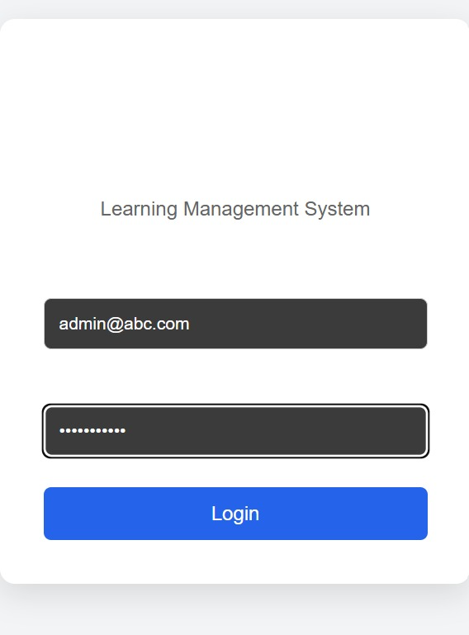
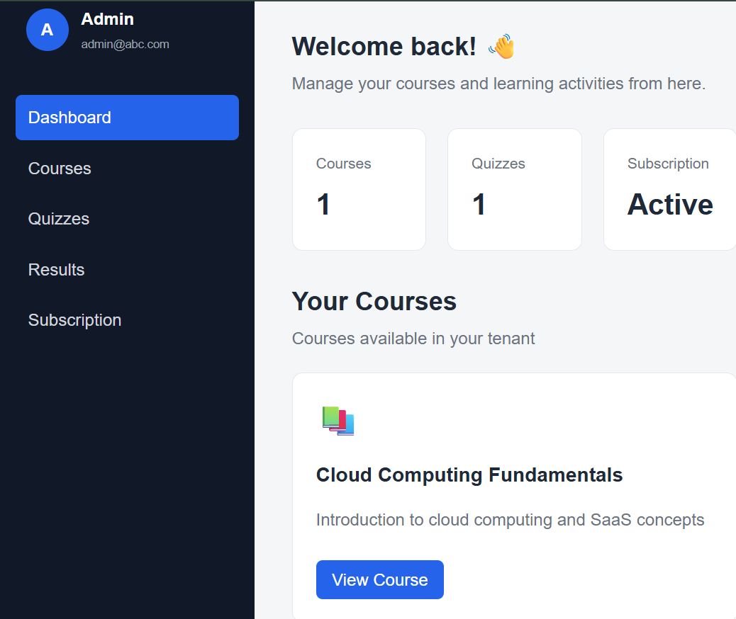
Module 1: Output

Slide 10
Module 2 – Course Content & Assessment
Course Management: Enables faculty to create, organize, update, and publish courses with structured modules and lessons.
Learning Content Management: Supports uploading and organizing PDFs, documents, videos, links, and other learning resources.
Student Enrollment: Allows students to enroll in assigned courses and access authorized learning materials.
Assessment Management: Enables faculty to create quizzes, assignments, and online assessments with configurable marks and deadlines.
Automated Evaluation: Automatically evaluates objective questions and calculates student scores, reducing manual grading effort.
Performance Tracking: Maintains assessment results, grades, submissions, and course progress for monitoring student performance.
Features
Course Creation & Management | Learning Material Upload | Student Enrollment | Quiz & Assignment Management | Automated Evaluation & Grading | Result & Progress Tracking
Notes:
Image source: https://pub.mdpi-res.com

Slide 11
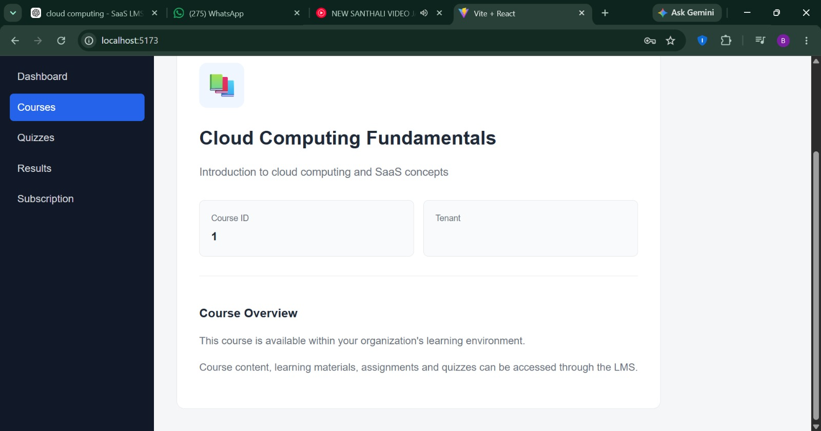
Module 2: Output

Slide 12
Module 3 – Cloud Deployment & Subscription Billing
Cloud Deployment: Deploys the LMS on cloud infrastructure for centralized access, availability, and easier maintenance.
Scalable Infrastructure: Uses load balancing and auto-scaling to handle increasing users and peak academic workloads.
Tenant Provisioning: Enables new institutions to be onboarded and configured efficiently within the SaaS platform.
Subscription Plan Management: Provides different plans based on institutional requirements, users, features, and resource limits.
Billing & Usage Tracking: Maintains subscription status, usage information, billing records, and payment details for each tenant.
Monitoring & Availability: Monitors cloud resources and application performance to maintain reliable service for all tenants
Features
Cloud Deployment | Load Balancing & Auto-scaling | Tenant Provisioning | Subscription Plan Management | Billing & Usage Tracking | Cloud Monitoring & Availability
Notes:
Image source: https://pub.mdpi-res.com

Slide 13
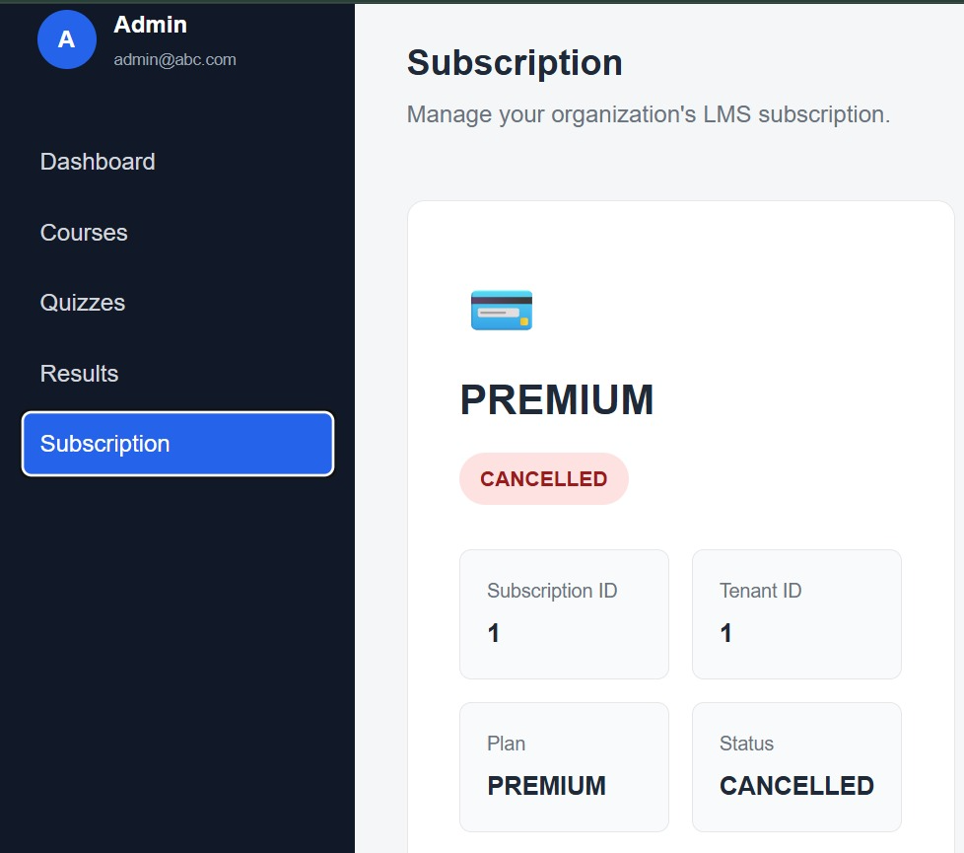
Module 3: Output

Slide 14
Techniques Used
Multi-Tenancy Architecture – Supports multiple institutions within a shared application.
SaaS Architecture – Provides the LMS as a centralized cloud-based service.
Role-Based Access Control (RBAC) – Controls access based on Administrator, Faculty, and Student roles.
JWT-Based Authentication – Provides secure user authentication and session management.
Containerization – Uses Docker and Docker Compose for consistent application deployment.
Cloud Deployment & Scalability – Uses AWS for cloud hosting and scalable application deployment.
Subscription & Payment Management – Uses Stripe for subscription plans and online billing.
Notes:
Image source: https://pub.mdpi-res.com

Slide 15
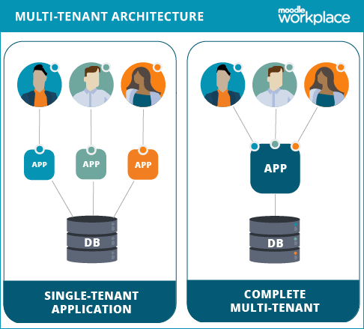
Applications
Schools & Colleges: Centralized management of students, faculty, courses, and assessments.
Universities: Supports multiple departments, campuses, and institutions through a shared SaaS platform.
Coaching & Training Institutes: Manages courses, batches, learning materials, tests, and student performance.
Corporate Training: Delivers employee training, assessments, certifications, and progress tracking.
Online Education Platforms: Provides scalable course delivery, user management, assessments, and subscription-based access.
Multi-Institution SaaS: Enables multiple organizations to use one cloud platform with tenant-wise data isolation and administration
Notes:
Image source: https://www.mdpi.com

Slide 16
Future Scope
AI-Powered Personalization: Recommend courses, learning materials, and assessments based on individual student performance.
Advanced Learning Analytics: Use predictive analytics to identify weak-performing and at-risk students.
AI-Based Assessment: Introduce automated grading, intelligent feedback, and AI-generated quizzes.
Mobile & Offline Learning: Provide mobile applications and low-bandwidth/offline access for continuous learning.
Advanced Cloud Scaling: Implement intelligent auto-scaling and resource optimization as the number of tenants and users increases.
Third-Party Integration: Integrate payment gateways, university ERP/SIS, video-conferencing, SSO, and other educational services through APIs.

Slide 17
Conclusion
Provides a secure multi-tenant LMS that enables multiple institutions to share a cloud platform while maintaining tenant-wise data isolation and role-based access.
Integrates complete learning management through course content, online assessments, student performance tracking, and centralized administration.
Offers a scalable SaaS solution with cloud deployment, subscription management, and billing, making the system suitable for growing educational institutions.
Enhances accessibility and efficiency by providing anytime, anywhere access to learning resources through a centralized cloud-based platform.
Notes:
Image source: https://pub.mdpi-res.com

Slide 18
References
Yasmeen, F., Pandey, S., Goel, P., Singh, B.P. and Mitra, A.R., 2026, May. A Scalable SaaS Framework for AI-Enabled Personalized Education: System Design, Implementation, and Evaluation. In 2026 IEEE 6th International Conference on Computing, Power, and Communication Technologies (IC2PCT) (pp. 1154-1160). IEEE.
Wang, H., Zheng, H. and Meng, F., 2018, October. Application of SaaS mode in customizable graduation design management system. In 2018 9th International Conference on Information Technology in Medicine and Education (ITME) (pp. 379-383). IEEE.
Yosep, D.R., Faisal, M.R., Budiman, I., Abadi, F., Saputro, S.W. and Hariyady, H., 2025, September. Design of Software as a Service Based Information System for Campus Cooperation Management using User-Centered Design. In 2025 8th International Conference of Computer and Informatics Engineering (IC2IE) (pp. 1-6). IEEE.
Golding, T., 2024. Building multi-tenant SaaS architectures. " O'Reilly Media, Inc.".
Mohamed, F., Mizouni, R., Abu-Matar, M., Al-Qutayri, M. and Whittle, J., 2017, August. An integrated platform for dynamic adaptation of multi-tenant single instance SaaS applications. In 2017 IEEE 5th International Conference on Future Internet of Things and Cloud (FiCloud) (pp. 257-264). IEEE.

Slide 19
Sharma, A. and Kaur, P., 2021. TOSDS: tenant-centric object-based software defined storage for multitenant saas applications. Arabian Journal for Science and Engineering, 46(9), pp.9221-9235.
Akinbode, G., 2022. Evaluation a Security Framework for Access Control in SaaS Systems (Doctoral dissertation, Dublin, National College of Ireland).
ANDRIIANENKO, O., 2026. Design and evaluation of multi-tenant architectures in microservice based project management systems (Doctoral dissertation, Universitatea Tehnică a Moldovei).
Sharma, R. and Coleman, S., 2026. Design and Development of a Cloud-Based Student Accommodation Management Application.
Budiarta, I.W.J., Iswara, I.B.A.I., Sukafona, I.M., Saraswati, N.W.S. and Udayana, I.P.A.E.D., 2026. Design and Construction of a SaaS-Based Multi-tenant Information System for Drone Activity Recording and Inventory. JST (Jurnal Sains dan Teknologi), 15(1), pp.70-81.

Slide 20


Slide 21
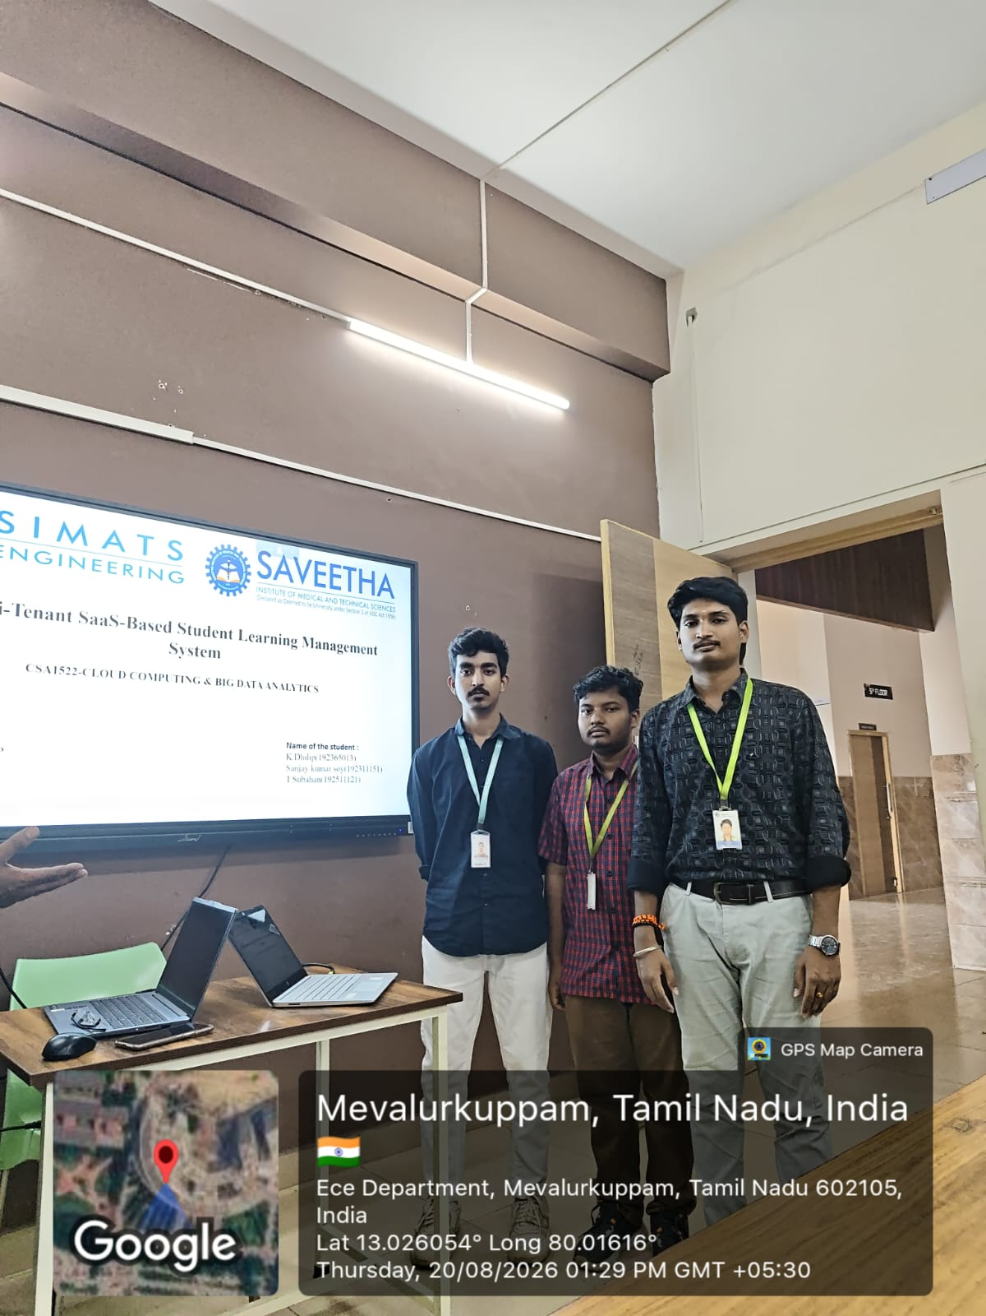
GPS Photo

